Slide 1
Is Instant Ramen becoming more popular.
Source of dataset: https://www.kaggle.com/epa/fuel-economy

Slide 2
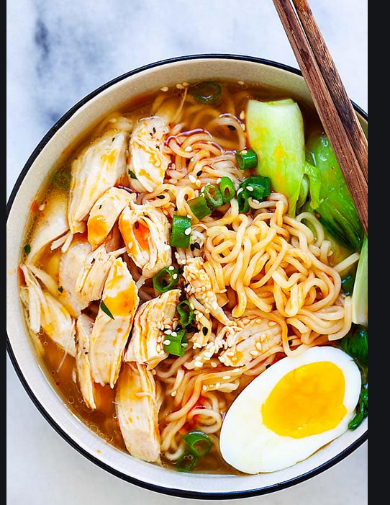
How many of you eat instant noodle / instant ramen every week, month, or once every couple month?
Is this a snack for you or a full meal replacement.
It is a meal replacement for me. I can add sliced beef with vegetable. I can even add a side of dumplings with this meal.

Slide 3
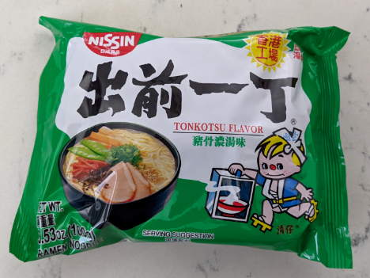
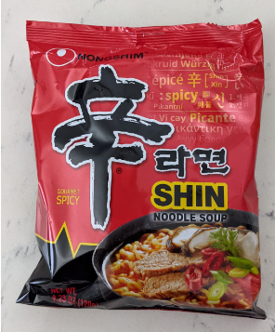
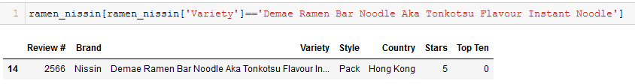
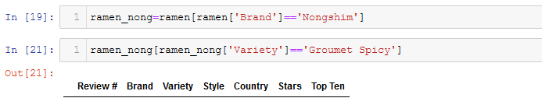
I want to know how my ramen is rated compare to other brands out there. Am I connoisseur or less than average taste for Ramen.
These are the brand of ramen I consume
I was unable to find this flavor in my rating

Slide 4
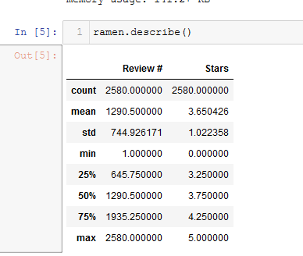
The average star rating for all the ramen is 3.75. The Ramen I like was has a rating of 5. I like noodle that are above average

Slide 5
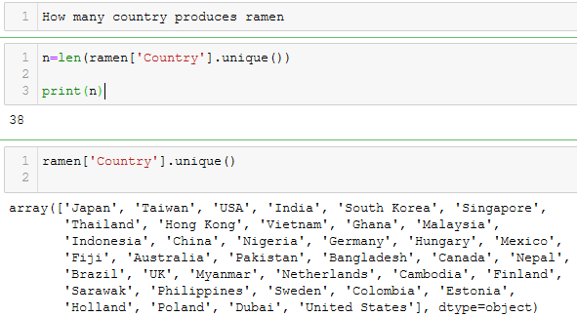
How many country do you think produces ramen?
There are

Slide 6
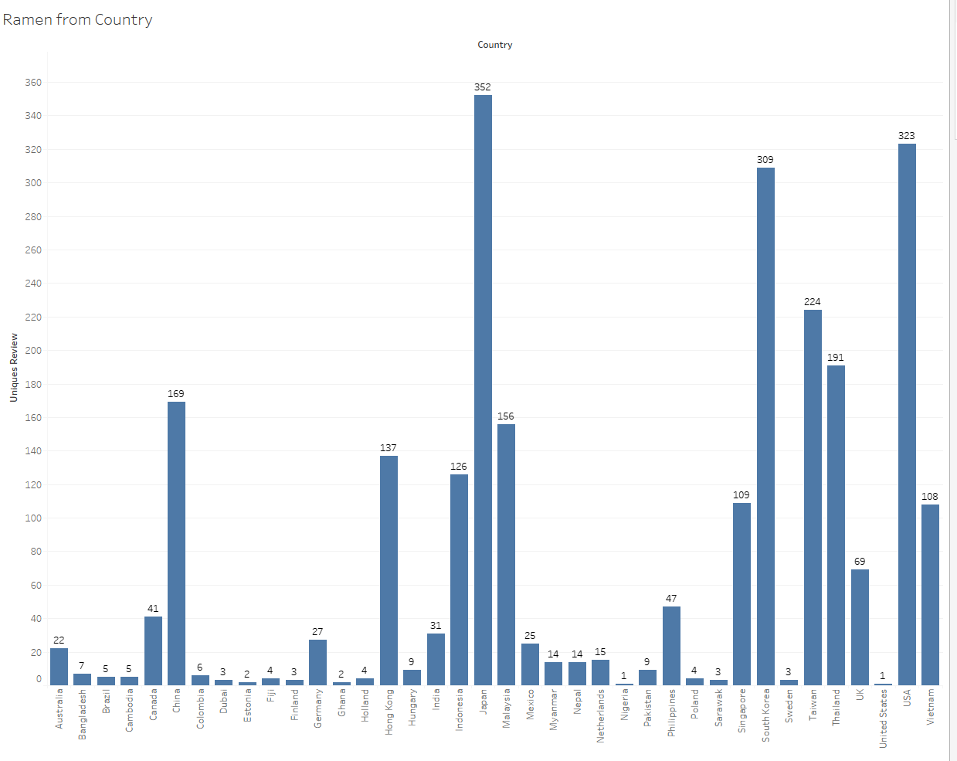
Her is a breakdown of how many product is produce in each country

Slide 7
From the production of instant ramen I can see that sales can only increase in the future as this product is produce from Asia, United States, Europe, Middle East, Africa.

